Slide 1
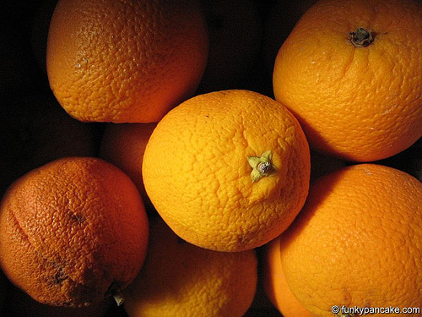
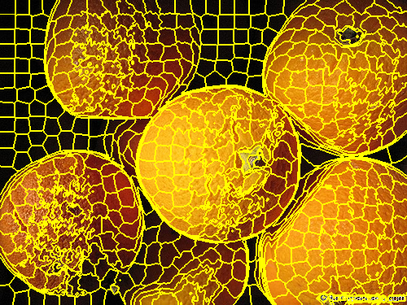


Image Classifier
Manish Borse, Shreya Gupta, Veera Karri and Nick Rosetti
CSE 4990/6990: Big Data and Data Science, Computer Science and Engineering
Introduction
Methodology
Conclusions
The process by which the entities in an image can be identified using various image processing algorithms is known as image classification. The output of an image classifier would be the “things” that can be identified in an image. For example, the classifier would identify that there is a cat, park and water fountain in a particular image. An application of classifying images would be to organize all our images. Google Photos, an image hosting website, uses an image classifier on all the images uploaded. To process huge amounts of image data, the algorithm used to classify images should be fast, efficient and accurate.
Started off with static number of clusters using K-means algorithm. Thereafter, we are using SLIC (simple linear iterative clustering) to split an image into similarly sized super pixels.
A super pixel is a collection of very similar non contiguous pixels. The super pixels are then quantified by a 4 D vector which is composed of median values of each color channel and the mean edge response.
A clustering algorithm called Dbscan (Density based spatial clustering of apps with noise) is used to cluster the set of vectors that represents all super pixels.
The clustered layer generated by Dbscan is then used to generate a set of feature vectors (1-D vector of numerical values that represent the layer). Following this, the feature vectors are used to create a machine learning SVM (Support Vector Machine) model. The model is then further used to predict what a given image contains.
The results are in the form of a list of tags and the associated probabilities for each image provided to the model.
Summary
Descriptive statistical analysis concluded that the entities within images are being predicted by the image classifier with an accuracy of 38%.
This is attributed to the feature vector. The usage of a different feature vector would yield different accuracy results.
Another factor is the amount of data used for training. Using more number of images which are also diverse in their content would yield more accurate results.
Research Question
How are images classified and what tools and machine learning algorithms would help make an accurate Image classifier?
Future Research
Investigations of different factors to form the basis for a feature vector that classifies the images with higher accuracy and draw conclusions about relations between various entities within the images.
Data Acquisition
Yahoo!’s Webscope has hosted the Yahoo Flickr Creative Commons 100M (14G).
Data set includes two types of files.
Image URL (10 files)
This set of files contains image IDs and the associated URL to download the image, among other attributes.
2) Auto-tags file
This file contains all the image IDs and associated (auto-generated) tags, which were generated by Flickr’s image classifying tool.
The dataset can be retrieved at:
https://webscope.sandbox.yahoo.com/catalog.php?datatype=i&did=67
References
Results
[1] E. Krotkov and J. Blitch, "The Defense Advanced Research Projects Agency (DARPA) Tactical Mobile Robotics Program," The International Journal of Robotics Research, vol. 18, pp. 769-776, July 1999.
[2] C. L. Bethel, D. Carruth, and T. Garrison, "Discoveries from Integrating Robots Into SWAT Team Training Exercises," in 10th IEEE International Symposium on Safety, Security, and Rescue Robotics, College Station, TX, 2012, pp. 1-8.
[3] M. C. Gazette, "Infantry Squad Tactics," in Military.com, ed: Marine Corps Gazette, 2005.

